Slide 1
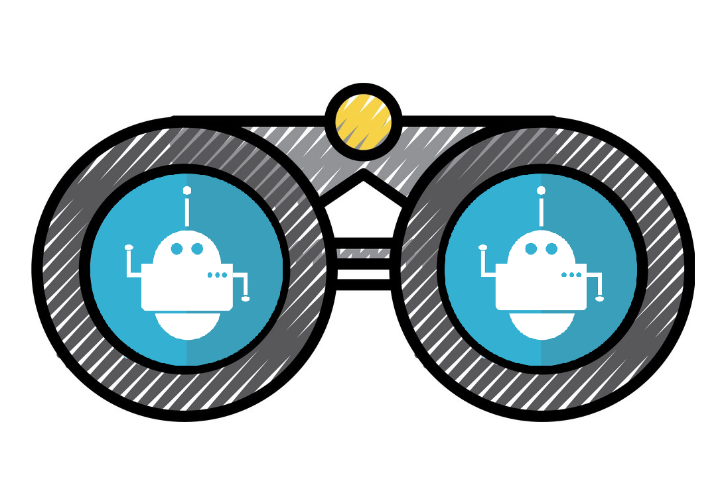
Data Scrap Bot
By:Jordan Winkler, Edwin Perez, Joseph Venanzio

Slide 2
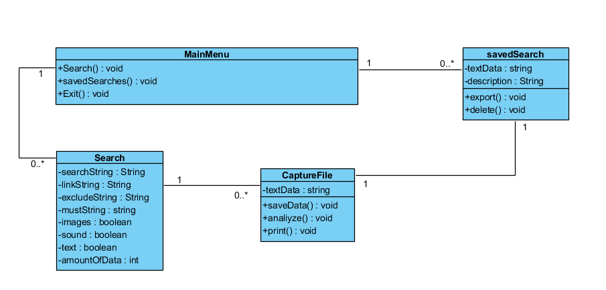
Class Diagram
Main Menu
Search
CaptureFile
SavedSearch

Slide 3
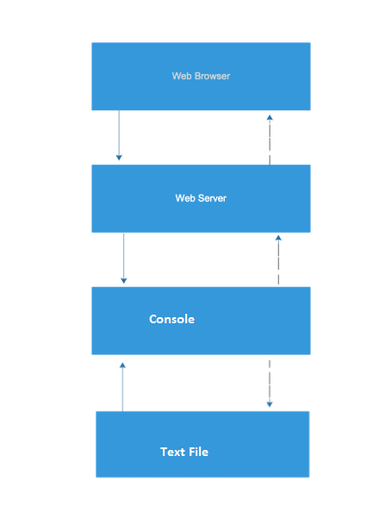
Architecture Design
Architecture Overview
Storage Layer
Application Layer
Access Layer

Slide 4
Detail Design
def htmlToText(htmlFile, textFile) :
def htmlToPictures(htmlFile, images):
def fileToStr (fileName) :
def pictureToMatrix(picture) :
def strCount (searchstr, string) :
def strLocate (searchstr, count='', string) :
def letterCount (string) :
def nletterCount (n, string) :
def imageCount (folder) :

Slide 5
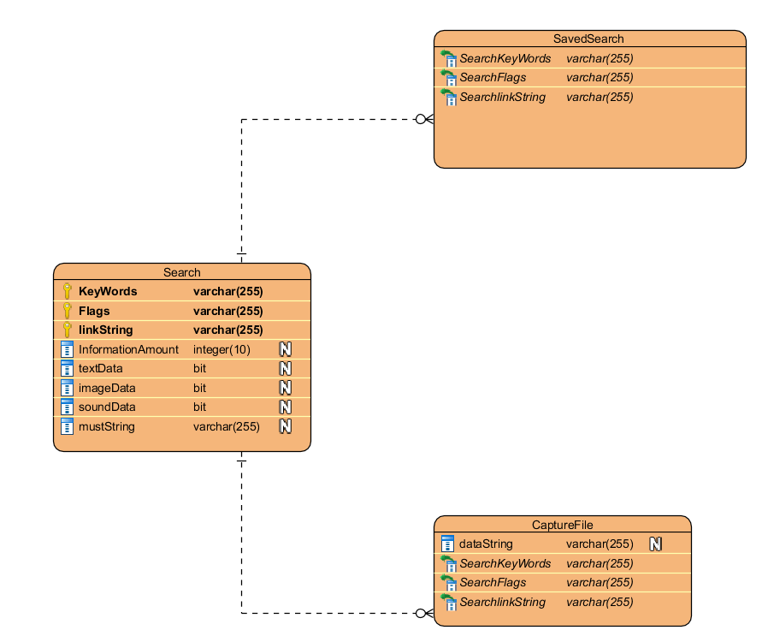
Database Design
The bot is not a database focussed program. So the database design is very simple. There are only 3 entities and two of the communicate with the primary one which is the user interface.

Slide 6
Software Interface Design
External Machine Interfaces
The program requires access to internet servers. The interface is also abstracted enough to work with common hardware used to access the internet.
External system Interfaces
The system interface required for this is the hypertext transfer protocol. The program will be using the given url address, or url reg-exp and extract the information desired.
Human Interfaces
The human interface will be mainly a terminal window open with a set of description of what they can do. The main target of the program is for programmers and having a terminal window open would be efficient for programmers to use. Also for use in scripting of other programs.

Slide 7
Appendices
Assumptions: Extract images and sound
Limitations: only works on terminal
Restrictions: Internet access

